Slide 1
Module 19 More About Inheritance & Recap
Exploring polymorphism
5.0

Slide 2
Main concepts
method polymorphism
static and dynamic type
overriding
dynamic method lookup
protected access
abstract classes
template method pattern
interfaces

Slide 3
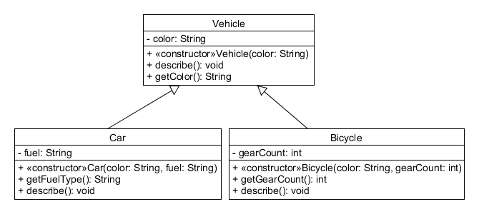
Inheritance Hierarchy
From Car we can access:
its own methods and attributes
the non-private methods of Vehicle

Slide 4
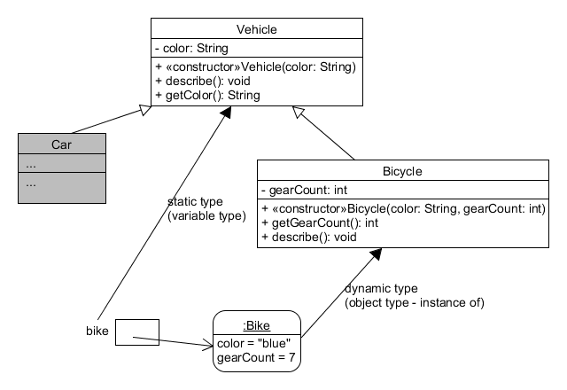
Inheritance Hierarchy
Vehicle bike = new Bicycle(”blue”, 7);
What happens here?
bike.describe();
What does Java do?
bike.getGearCount();
?

Slide 5
Case: Custom Output Wanted
Leonardo da Vinci
Had a great idea this morning.
But now I forgot what it was. Something to do with flying ...
40 seconds ago - 2 people like this.
No comments.
Alexander Graham Bell
[experiment.jpg]
I think I might call this thing 'telephone'.
12 minutes ago - 4 people like this.
No comments.
What we want
Leonardo da Vinci
40 seconds ago - 2 people like this.
No comments.
Alexander Graham Bell
12 minutes ago - 4 people like this.
No comments.
What we have

Slide 6
Static type and dynamic type
A more complex type hierarchy requires further concepts to describe it.
Some new terminology:
static type
dynamic type
method dispatch/lookup

Slide 7
Static and dynamic type
What is the type of c1?
Car c1 = new Car(“blue”, “gas”);
What is the type of v1?
Vehicle v1 = new Car(“blue”, “gas”);

Slide 8
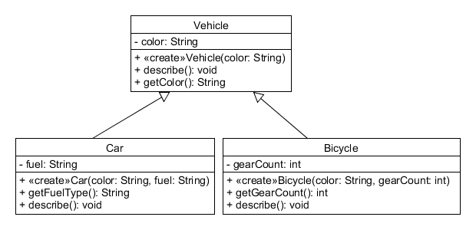
Overriding
Same signature
Superclass satisfies static type check.
Subclass method is called at runtime – it overrides the superclass version.
What becomes of the superclass version?

Slide 9
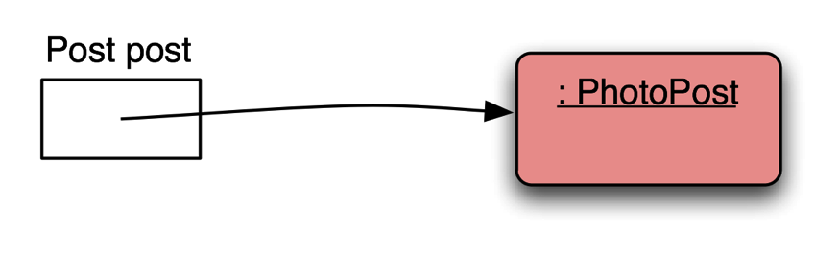
Distinct static and dynamic types

Slide 10
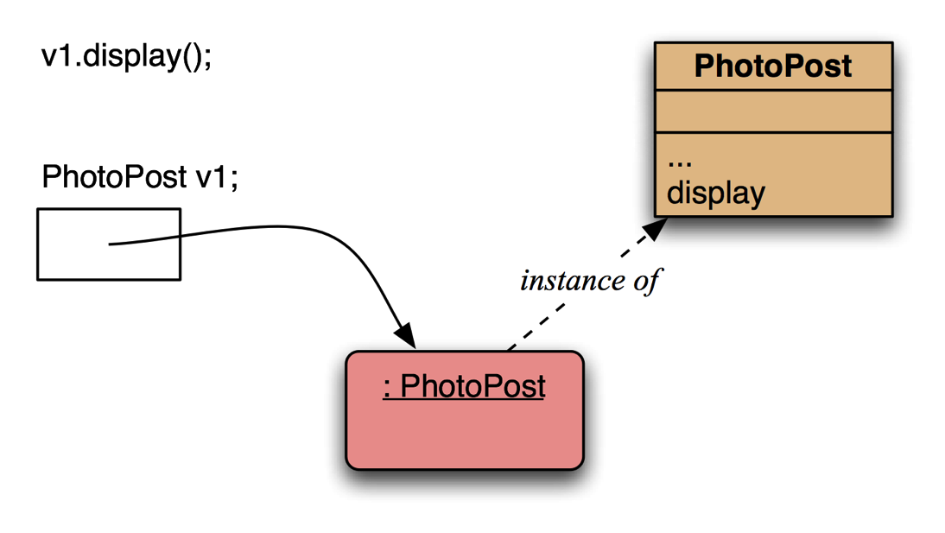
Method lookup
No inheritance or polymorphism.
The obvious method is selected.

Slide 11
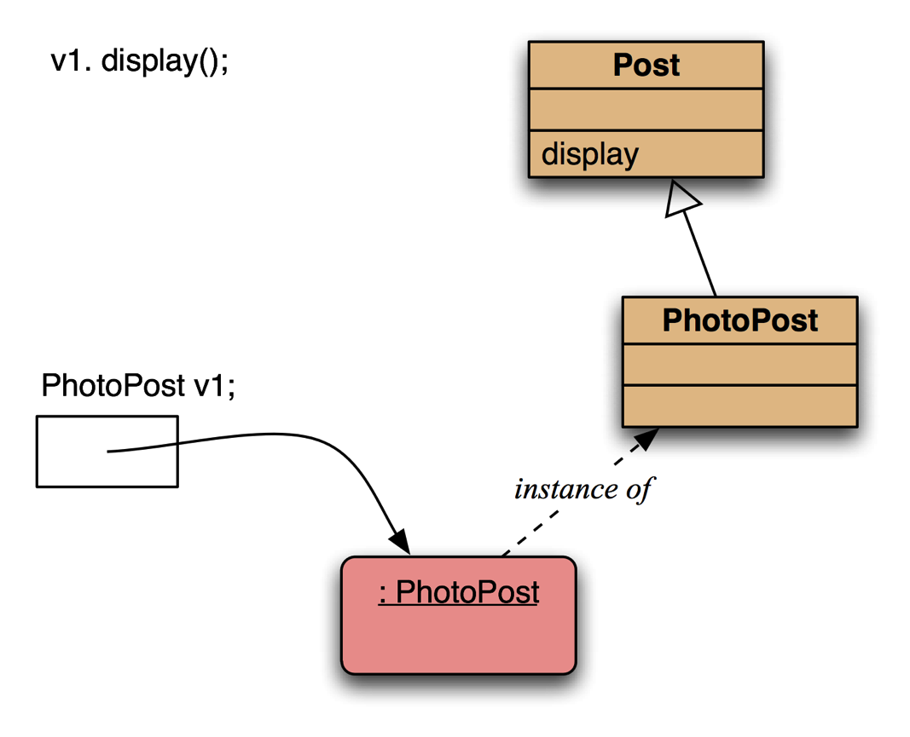
Method lookup
Inheritance but no overriding. The inheritance hierarchy is ascended, searching for a match.

Slide 12
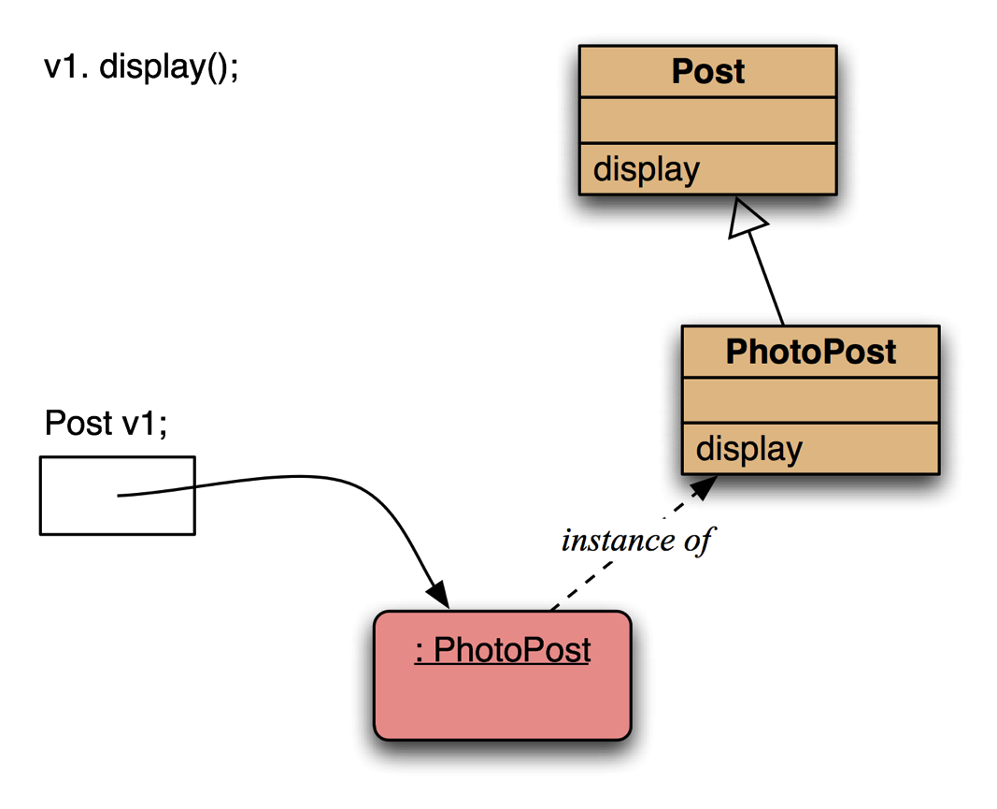
Method lookup
Polymorphism and overriding. The ‘first’ version found is used.

Slide 13
Method lookup summary
The variable is accessed.
The object stored in the variable is found.
The class of the object is found.
The class is searched for a method match.
If no match is found, the superclass is searched.
4-5 is repeated until a match is found, or the class hierarchy is exhausted.
Overriding methods take precedence.

Slide 14
Super call in methods
Overridden methods are hidden ...
... but we often still want to be able to call them.
An overridden method can be called from the method that overrides it.
super.method(...)
Compare with the use of super in constructors.

Slide 15
Calling an overridden method
public void display(){
super.display();
System.out.println(" [" + filename + "]");
System.out.println(" " + caption);
}

Slide 16
Method polymorphism
We have been discussing polymorphic method dispatch.
A polymorphic variable can store objects of varying types.
Method calls are polymorphic.
The actual method called depends on the dynamic object type.

Slide 17
The instanceof operator
Used to determine the dynamic type.
Recovers ‘lost’ type information.
Usually precedes assignment with a cast to the dynamic type:
if(post instanceof MessagePost) { MessagePost msg = (MessagePost) post; //… access MessagePost methods via msg … }

Slide 18
Methods in the Object class
Methods in Object are inherited by all classes.
Any of these may be overridden.
The toString method is commonly overridden:
public String toString()
Returns a string representation of the object.

Slide 19
Overriding toString in Post
@Override
public String toString() {
String text = username + "\n" +
timeString(timestamp);
if(likes > 0) {
text += " - " + likes + " people like this.\n";
}
else{
text += "\n";
}
if(comments.isEmpty()) {
return text + " No comments.\n";
}
else{
return text + " " + comments.size() +
" comment(s). Click here to view.\n";
}
}

Slide 20
StringBuilder
The efficient way to combine Strings
* Preferred *
Consider using StringBuilder as an alternative to concatenation:
StringBuilder builder = new StringBuilder(); builder.append(username); builder.append('\n'); builder.append(timeString(timestamp)); ... return builder.toString();

Slide 21
Protected access
Private access in the superclass may be too restrictive for a subclass.
The closer inheritance relationship is supported by protected access.
UML: #
Protected access is more restricted than public access.
We still recommend keeping fields private.
Define protected accessors and mutators.

Slide 22
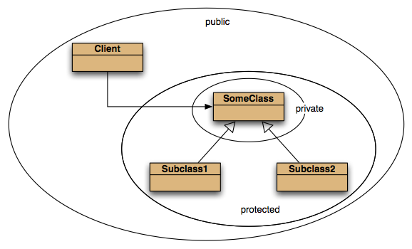
Access levels (Book)

Slide 23
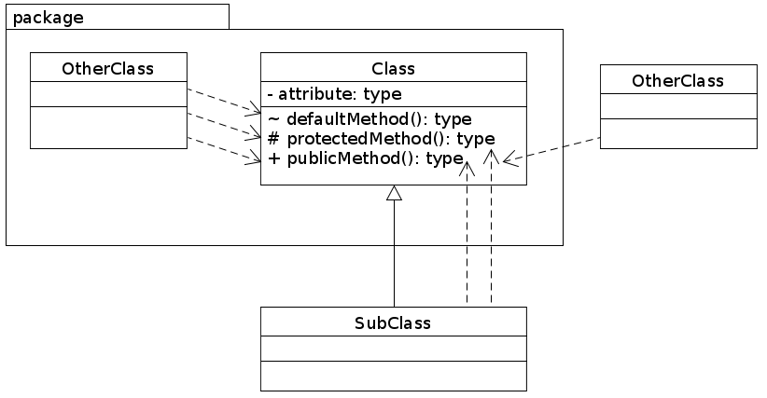
Access Levels (correct)

Slide 24
Access modifiers
Public
Access is for everybody
Private
Can only be used within the class
Protected
Can only be used by subclasses or package members
Package protected / Default visibility
We don’t write any visibility and it defaults to this
Can only be used by package members
Doesn’t matter if subclass or not

Slide 25
Review
The declared type of a variable is its static type.
Compilers check static types.
The type of an object is its dynamic type.
Dynamic types are used at runtime.
Methods may be overridden in a subclass.
Method lookup starts with the dynamic type.
Protected access supports inheritance.

Slide 26
Before the next part
Make a disposable copy of the newsfeed project
Open it in BlueJ and be ready to experiment

Slide 27
Module 21.2
Abstract Classes and Interfaces

Slide 28
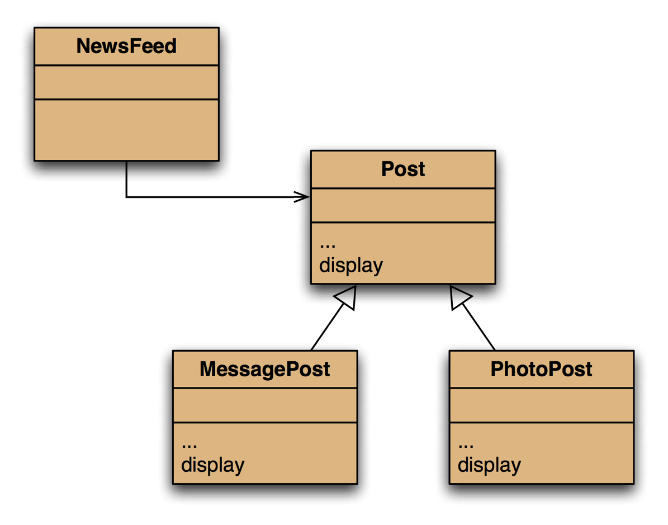
Classes that can’t be instantiated?
Do we need to be able to instantiate all classes?
Post objects don’t make sense
A post is either a
MessagePost, or a
PhotoPost

Slide 29
Abstract classes and abstract methods
In this situation we want classes which we will only inherit from. This kind of class is called abstract class:
Abstract classes cannot be instantiated
Therefore, abstract classes can only be the static type.
Abstract classes can contain abstract methods.
Abstract methods are declared abstract.
UML: italic
There is no implementation in an abstract method.
And they end in a semicolon ;
Only abstract classes can contain abstract methods
Subclasses must implement the abstract methods.
If they themselves are not abstract.

Slide 30
Newsfeed as-is
Message post:
Banana Joe
2 minutes ago - 3 people like this.
1 comment(s). Click here to view.
This is a great day - have a banana!
Our implementation forces us to
call the display() method on the superclass before/after, therefore
we can’t inject the content from the subclass in the middle
public void display() {
super.display();
System.out.println(message);
}

Slide 31
What we want
No instantiation possible for Post
Post objects have no meaningful content
display() should look like this:
As-is:
To be:
Message post:
Banana Joe
2 minutes ago - 3 people like this.
1 comment(s). Click here to view.
This is a great day - have a banana!
Message post:
Banana Joe
2 seconds ago
This is a great day - have a banana!
- 3 people like this.
1 comment(s). Click here to view.

Slide 32
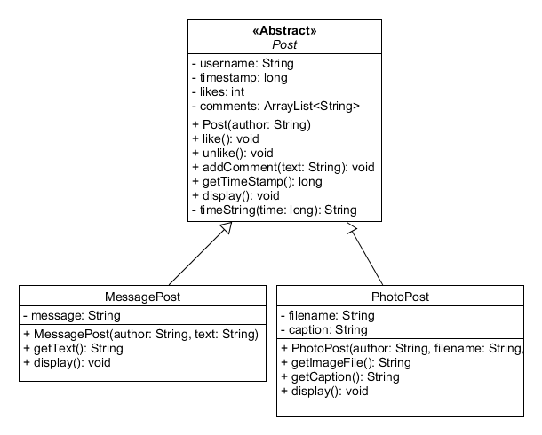
Abstract Post class – can’t instantiate
Post is declared abstract
Stereotype <<Abstract>>
Class name in italics
Now we can’t instantiate Post
Java:
public abstract class Post{

Slide 33
Abstract classes can’t be instantiated
public abstract class Post{
...
}
Static & dynamic type
public class MessagePost extends Post{
...
}
No change here
public class PhotoPost extends Post{
...
}
Post mp = new MessagePost("Joe", "Hi!");
Post pp = new PhotoPost("Joe","file",”fruit");
Post post = new Post("Joe");

Slide 34
Try it for yourselves!
Copy the Newsfeed project, so you can fall back on an unmodified version
Declare the Post class abstract
Write a test method and try to instantiate the three classes:
Use a JUnit test case, or just a plain old Java class
MessagePost mp = new MessagePost(…);
PhotoPost pp = new PhotoPost(…);
Post mpp = new MessagePost(…);
Post ppp = new PhotoPost(…);
Post post = new Post(…);
See what options BlueJ gives you when right-clicking all three classes

Slide 35
Abstract classes
Using ”abstract”, we can declare classes that we can only inherit from
What about functionality that only has meaning in a subclass?
What if we could say that the functionality will be there, we just don’t know how it is implemented?
Abstract methods.

Slide 36
Abstract methods
Implementing the better display() functionality
The superclass provides the display() method
Subclasses inherit it
Subclasses can override it
This is what we did
super.display();
Now, we will try something new

Slide 37
What we want
Done
No instantiation possible for Post
Post objects have no meaningful content
display() should look like this:
As-is:
To be:
Message post:
Banana Joe
2 minutes ago - 3 people like this.
1 comment(s). Click here to view.
This is a great day - have a banana!
Message post:
Banana Joe
2 seconds ago
This is a great day - have a banana!
- 3 people like this.
1 comment(s). Click here to view.

Slide 38
Post.display()
public void display(){
if(this instanceof MessagePost) {
System.out.println("Message post: ");
}
else {
System.out.println("Photo post");
}
System.out.println(username);
System.out.print(timeString(timestamp));
if(likes > 0) {
System.out.println(" - " + likes + " people like this.");
}
else {
System.out.println();
}
if(comments.isEmpty()) {
System.out.println(" No comments.");
}
else {
System.out.println(" " + comments.size() + " comment(s).
Click here to view.");
}
}
Print subclass specific content here

Slide 39
Post.display()
public void display(){
if(this instanceof MessagePost) {
System.out.println("Message post: ");
}
else {
System.out.println("Photo post");
}
System.out.println(username);
System.out.print(timeString(timestamp));
doDisplay();
if(likes > 0) {
System.out.println(" - " + likes + " people like this.");
}
else {
System.out.println();
}
if(comments.isEmpty()) {
System.out.println(" No comments.");
}
else {
System.out.println(" " + comments.size() + " comment(s).
Click here to view.");
}
}
Print subclass specific content here

Slide 40
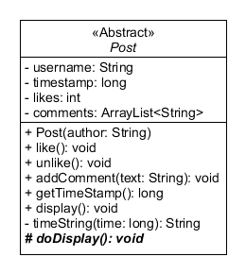
Abstract methods
A method that only makes
sense in the subclasses
doDisplay() doesn’t exist yet
We add an abstract method to the superclass:
public abstract class Post{
...
protected abstract void doDisplay();
}
It’s abstract: italics (UML)
It’s protected: # (UML)
We can now call it from display()

Slide 41
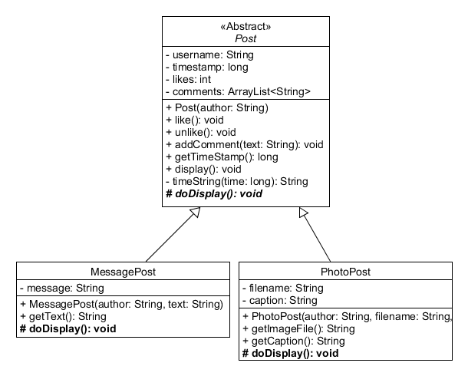
Subclasses implement abstract methohds
Implementation:
Not abstract
Not italics

Slide 42
MessagePost & PhotoPost updated
Practical note:
We changed the old display() methods in the subclasses
MessagePost:
@Override
protected void doDisplay() {
//super.display();
System.out.println(message);
}
PhotoPost:
@Override
protected void doDisplay() {
//super.display();
System.out.println("[" + filename + "]");
System.out.println(caption);
}

Slide 43
What we want
Done
No instantiation possible for Post
Post objects have no meaningful content
display() should look like this:
Done
As-is:
To be:
Message post:
Banana Joe
2 minutes ago - 3 people like this.
1 comment(s). Click here to view.
This is a great day - have a banana!
Message post:
Banana Joe
2 seconds ago
This is a great day - have a banana!
- 3 people like this.
1 comment(s). Click here to view.

Slide 44
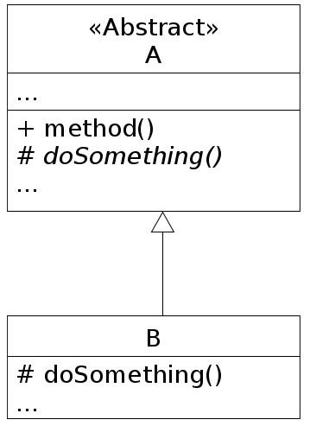
Patterns
Great solution – let’s describe it
That’s what we have patterns for
Template Method Pattern
Abstract superclass
Abstract (template) method(s)
Named do…()
Template methods invoked from ordinary methods in superclass
Concrete subclass implements functionality of do…() methods

Slide 45
Again,
Abstract class
Keyword abstract
Can’t be instantiated
We can only inherit from it
Static type
Can contain abstract methods
Abstract method
With keyword abstract, and no body, has a semicolon ; instead
Must be implemented in subclass
If subclass is not abstract itself

Slide 46
Try it for yourselves
Add the abstract method doDisplay() to Post
Implement doDisplay() in the subclasses of Post
Modify the existing display() methods
Stack overflow?
Tip: Don’t call the super method any more – why?
You may need to change the formatting of the Post.display() method – insert and remove linebreaks to make it look nice.

Slide 47
Interfaces
What if we want to inherit from multiple classes?
The diamond problem
Which version of identical methods?
Java doesn’t allow it: single inheritance
What if we only want to provide the interface of a class?
Only provide the method signature
Allow only abstract methods
A special, purely abstract class is called an Interface

Slide 48
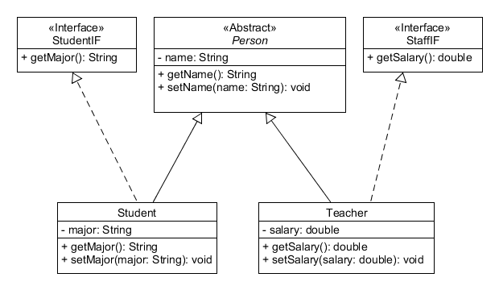
Provide only the interface of a class

Slide 49
Interface (1)
With an interface:
We promise key functionality to the rest of the program
We can implement the details in classes
Examples:
java.util.List
ArrayList, LinkedList
MyOwnFancyList?
java.util.Iterator

Slide 50
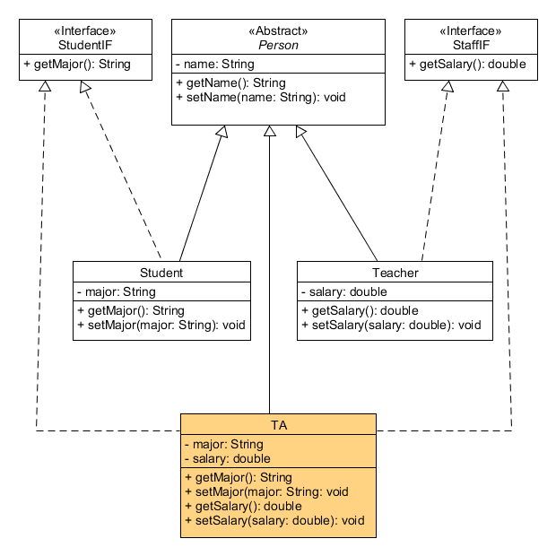
Implement multiple interfaces

Slide 51
Interface (2)
TA (teaching assistant)
Both StudentIF, and
StaffIF
Can be processed as a
Student, and as
Staff

Slide 52
Interfaces are types, like abstract classes
Person p1 = new Student();
Student s1 = new Student();
StudentIF sif = new Student();
Person p2 = new Teacher();
Teacher t1 = new Teacher();
StaffIF staff1 = new Teacher();
Person p3 = new TA();
TA ta1 = new TA();
StaffIF staff2 = new TA();
StudentIF s3 = new TA();
StudentIF s4 = ta1;
StaffIF staff3 = (StaffIF)p3;
Person p4 = (Person)s3;
TA ta2 = (TA)p4;

Slide 53
Interfaces in Java
We use the interface keyword to declare interfaces
We add only abstract methods
Without the keyword abstract!
We can’t add a constructor
public interface StudentIF {
public String getMajor();
}

Slide 54
Interfaces in Java
We use the implements keyword
public class Student implements StudentIF {…
We can implement multiple intefaces
Use a comma separated list of interfaces
public class TA implements StudentIF, StaffIF{
Combining inheritance and impelmentation of interfaces
public class Student extends Person implements StudentIF {…

Slide 55
An Interface is a specification
Separates functionality (what) from implementation (how)
Parameters and return types are defined.
Clients are not dependent of the implementation.
So we can change it without affecting the client.

Slide 56
Try it for yourselves
Implement the Student & Staff class diagram
Try the instantiations in a test method (in a test class)
When done:
Study the class diagram
Could it be done better?
Rearrange the inhertiance hierarchy to avoid code duplication!

Slide 57
Exercise
Complete the Vehicle-Bicycle-Car exercise
Complete the remaining exercises in chapter 8
Solve exercises in chapter 9
Solve the Yacht Club exercise

